Slide 1
Cornerstone City Church Peninsula Plus Community Hoo Are Ya
18th May 2025

Slide 2
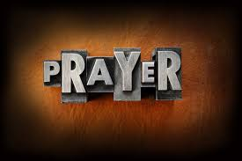

Slide 3
I reach Up High
CCLI Song # 1075387
Judy Bailey
© 1993 Song Solutions Daybreak (Admin. by Song Solutions www.songsolutions.org)
For use solely with the SongSelect® Terms of Use. All rights reserved. www.ccli.com
CCLI Licence No. 33265

Slide 4
1/3
I reach up high I touch the ground
I stomp my feet and turn around
I've got to (woo woo) Praise the Lord
I jump and dance with all my might
I might look funny but that's alright
I've got to (woo woo)
Praise my Lord

Slide 5
2/3
I'll do anything just for my God
'Cause He's done ev'rything for me
It doesn't matter who is looking on
Jesus is the person that I want to please

Slide 6
3/3
May my whole life be a song of praise
To worship God in ev'ry way
In this song the actions praise His name
I want my actions ev'ry day to do the same

Slide 7
Praise
CCLI Song # 7213077
© Brandon Lake MusicFor Humans PublishingMaverick City PublishingCapitol CMG GenesisCapitol CMG ParagonHousefires SoundsWriter's Roof PublishingMusic by Elevation Worship Publishing
For use solely with the SongSelect® Terms of Use. All rights reserved. www.ccli.com
Note: Reproduction of this sheet music requires a CCLI Music Reproduction Licence. Please report all copies.
CCLI Licence No. 33265

Slide 8
1/12
Let everything that has breath
Praise the Lord
Praise the Lord

Slide 9
2/12
I’ll praise in the valley
Praise on the mountain
I’ll praise when I’m sure
Praise when I’m doubting

Slide 10
3/12
I’ll praise when outnumbered
Praise when surrounded
'Cause praise is the water
My enemies drown in

Slide 11
4/12
As long as I’m breathing
I’ve got a reason to Praise the Lord oh my soul
Praise the Lord oh my soul

Slide 12
5/12
I’ll praise when I feel it
And I’ll praise when I don’t
I’ll praise 'cause I know
You’re still in control

Slide 13
6/12
'Cause my praise is a weapon
It’s more than a sound
My praise is the shout
That brings Jericho down

Slide 14
7/12
As long as I’m breathing
I’ve got a reason to Praise the Lord oh my soul
Praise the Lord oh my soul

Slide 15
8/12
I won’t be quiet
My God is alive
How could I keep it inside
Praise the Lord oh my soul

Slide 16
9/12
I’ll praise 'cause You’re sovereign
Praise 'cause You reign
Praise 'cause You rose and defeated the grave
I’ll praise 'cause You’re faithful
Praise 'cause You’re true
Praise 'cause there’s nobody greater than You

Slide 17
10/12
Praise the Lord oh my soul
Praise the Lord oh my soul
Praise the Lord oh my soul
Praise the Lord oh my soul
I won’t be quiet
My God is alive
How could I keep it inside

Slide 18
1 1/12
I won’t be quiet
My God is alive
How could I keep it inside
I won’t be quiet
My God is alive
How could I keep it inside
Praise the Lord oh my soul

Slide 19
12/12
Let everything that has breath
Praise the Lord
Praise the Lord

Slide 20
House Of The Lord
CCLI Song # 7168995
© 2020 Phil Wickham MusicSimply Global SongsBe Essential SongsCashagamble Jet Music
For use solely with the SongSelect® Terms of Use. All rights reserved. www.ccli.com
Note: Reproduction of this sheet music requires a CCLI Music Reproduction Licence. Please report all copies.
CCLI Licence No. 33265

Slide 21
1/9
We worship the God who was
We worship the God who is
We worship the God who evermore will be
He opened the prison doors
He parted the raging sea
My God He holds the victory yeah

Slide 22
2/9
There’s joy in the house of the Lord
There’s joy in the house of the Lord today
And we won’t be quiet
We shout out Your praise

Slide 23
3/9
There’s joy in the house of the Lord
Our God is surely in this place
And we won’t be quiet
We shout out Your praise

Slide 24
4/9
We sing to the God who heals
We sing to the God who saves
We sing to the God who always makes a way
'Cause He hung up on that cross
Then He rose up from that grave
My God’s still rolling stones away

Slide 25
5/9
There’s joy in the house of the Lord
There’s joy in the house of the Lord today
And we won’t be quiet
We shout out Your praise

Slide 26
6/9
There’s joy in the house of the Lord
Our God is surely in this place
And we won’t be quiet
We shout out Your praise

Slide 27
7/9
We were the beggars
Now we’re royalty
We were the prisoners
Now we’re running free
We are forgiven accepted
Redeemed by His grace
Let the house of the Lord sing praise
(REPEAT)

Slide 28
8/9
There’s joy in the house of the Lord
There’s joy in the house of the Lord today
And we won’t be quiet
We shout out Your praise

Slide 29
9/9
There’s joy in the house of the Lord
Our God is surely in this place
And we won’t be quiet
We shout out Your praise

Slide 31
Goodness Of God
CCLI Song # 7117726
Ben Fielding | Brian Johnson | Ed Cash | Jason Ingram | Jenn Johnson
© 2018 Capitol CMG Paragon (Admin. by Capitol CMG Publishing)
Fellow Ships Music (Admin. by Essential Music Publishing LLC)
So Essential Tunes (Admin. by Essential Music Publishing LLC)
SHOUT! Music Publishing Australia (Admin. by SHOUT! Music Publishing UK)
Bethel Music Publishing (Admin. by Song Solutions)
For use solely with the SongSelect® Terms of Use. All rights reserved. www.ccli.com
CCLI Licence No. 33265

Slide 32
1/6
I love You Lord
Oh Your mercy never fails me
All my days
I've been held in Your hands
From the moment that I wake up
Until I lay my head
I will sing of the goodness of God

Slide 33
2/6
All my life You have been faithful
All my life You have been so so good
With every breath that I am able
I will sing of the goodness of God

Slide 34
3/6
I love Your voice
You have led me through the fire
In darkest night
You are close like no other
I've known You as a father
I've known You as a friend
I have lived in the goodness of God

Slide 35
4/6
All my life You have been faithful
All my life You have been so so good
With every breath that I am able
I will sing of the goodness of God

Slide 36
5/6
Your goodness is running after
It’s running after me
(REPEAT)
With my life laid down
I’m surrendered now
I give You everything
Your goodness is running after
It's running after me

Slide 37
6/6
All my life You have been faithful
All my life You have been so so good
With every breath that I am able
I will sing of the goodness of God

Slide 38
Worthy Of it All
CCLI Song # 6280644
David Brymer | Ryan Hall
© 2012 Common Hymnal Publishing (Admin. by Integrity Music Ltd)
Innerland (Admin. by Integrity Music Ltd)
Underground Treasure (Admin. by Integrity Music Ltd)
Wayfinder Music (Admin. by Integrity Music Ltd)
For use solely with the SongSelect® Terms of Use. All rights reserved. www.ccli.com
CCLI Licence No. 33265

Slide 39
1/4
All the saints and angels
Bow before Your throne
All the elders cast their crowns
Before the Lamb of God and sing

Slide 40
2/4
You are worthy of it all
You are worthy of it all
For from You are all things
And to You are all things
You deserve the glory

Slide 41
3/4
Day and night,
Night and day,
Let incense arise
(X4)
Day and night
Night and day

Slide 42
4/4
You are worthy of it all
You are worthy of it all
For from You are all things
And to You are all things
You deserve the glory

Slide 44
Holy Forever
CCLI Song # 7201044
Brian Johnson | Chris Tomlin | Jason Ingram | Jenn Johnson | Phil Wickham
© Phil Wickham Music (Admin. by / Small Stone Media BV, Holland (Admin. in the UK/Eire by Song Solutions www.songsolutions.org))
Simply Global Songs (Admin. by / Small Stone Media BV, Holland (Admin. in the UK/Eire by Song Solutions www.songsolutions.org))
Capitol CMG Paragon (Admin. by Capitol CMG Publishing)
S. D. G. Publishing (Admin. by Capitol CMG Publishing)
Be Essential Songs (Admin. by Essential Music Publishing LLC)
My Magnolia Music (Admin. by Essential Music Publishing LLC)
Bethel Music Publishing (Admin. by Song Solutions)
Brian and Jenn Publishing (Admin. by Song Solutions)
For use solely with the SongSelect® Terms of Use. All rights reserved. www.ccli.com
CCLI Licence No. 33265

Slide 45
1/10
A thousand generations falling down in worship
To sing the song of ages to the Lamb
And all who've gone before us
And all who will believe
Will sing the song of ages to the Lamb

Slide 46
2/10
(Jesus) Your name is the highest
Your name is the greatest
Your name stands above them all
All thrones and dominions
All powers and positions
Your name stands above them all

Slide 47
3/10
And the angels cry Holy
All creation cries Holy
You are lifted high Holy
Holy forever

Slide 48
4/10
If you've been forgiven and if you've been redeemed
Sing the song forever to the Lamb
If you walk in freedom and if you bear His name
Sing the song forever to the Lamb
We'll sing the song forever and amen

Slide 49
5/10
And the angels cry Holy
All creation cries Holy
You are lifted high Holy
Holy forever

Slide 50
6/10
Hear Your people sing Holy
To the King of Kings Holy
You will always be Holy
Holy forever

Slide 51
7/10
(Jesus) Your name is the highest
Your name is the greatest
Your name stands above them all
All thrones and dominions
All powers and positions
Your name stands above them all

Slide 52
8/10
And the angels cry Holy
All creation cries Holy
You are lifted high Holy
Holy forever

Slide 53
9/10
Hear Your people sing Holy
To the King of Kings Holy
You will always be Holy
Holy forever

Slide 54
10/10
You will always be Holy
Holy forever

Slide 55


Slide 56


Slide 57


Slide 58
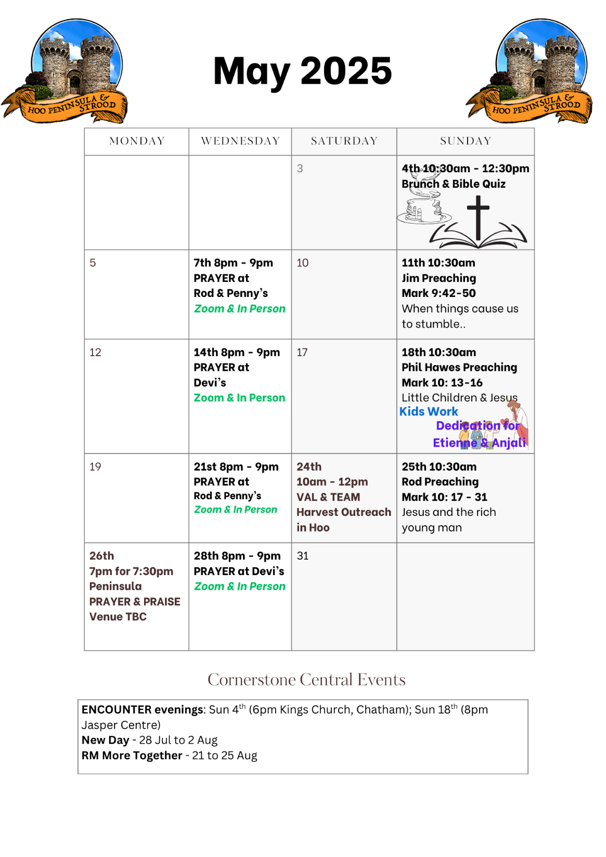

Slide 59

Grow Group 1
On YOUR MARK!

Slide 60
Leaders
Leaderss
Phil & Kim
Maria (Mia) Warren
Matthew Harrison
Richard & Elisha Acheampong
Phil & Kim
Maria (Mia) Warren
Matthew Harrison
Richard & Elisa Acheampong

Slide 61
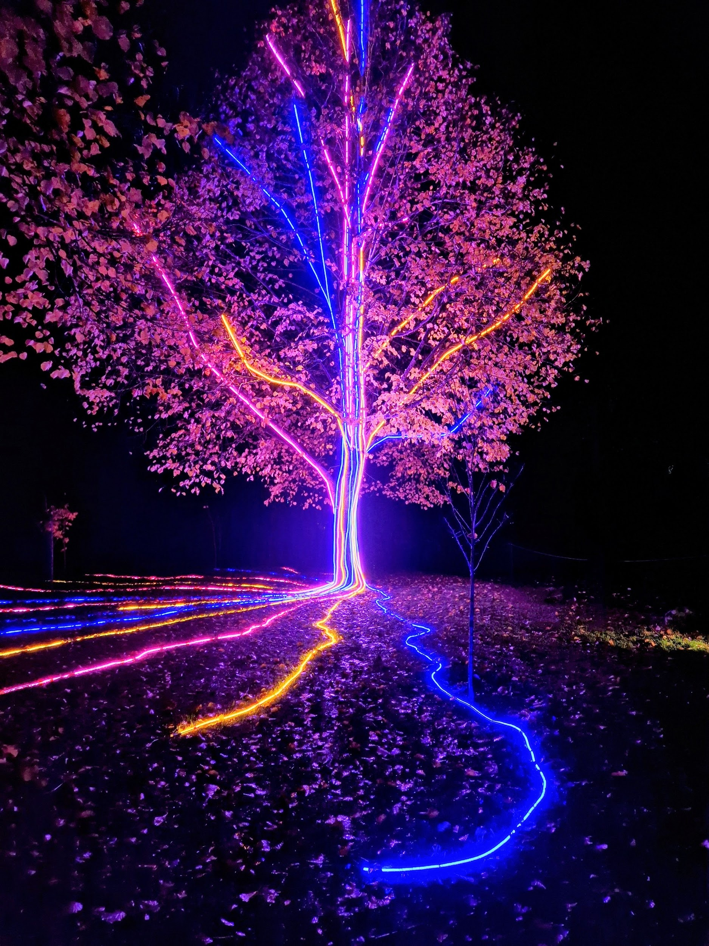
Storm Walker
Storm Walker
Symbolising, trust in Jesus Christ through life's storms.
Mark 4:35-41

Slide 62
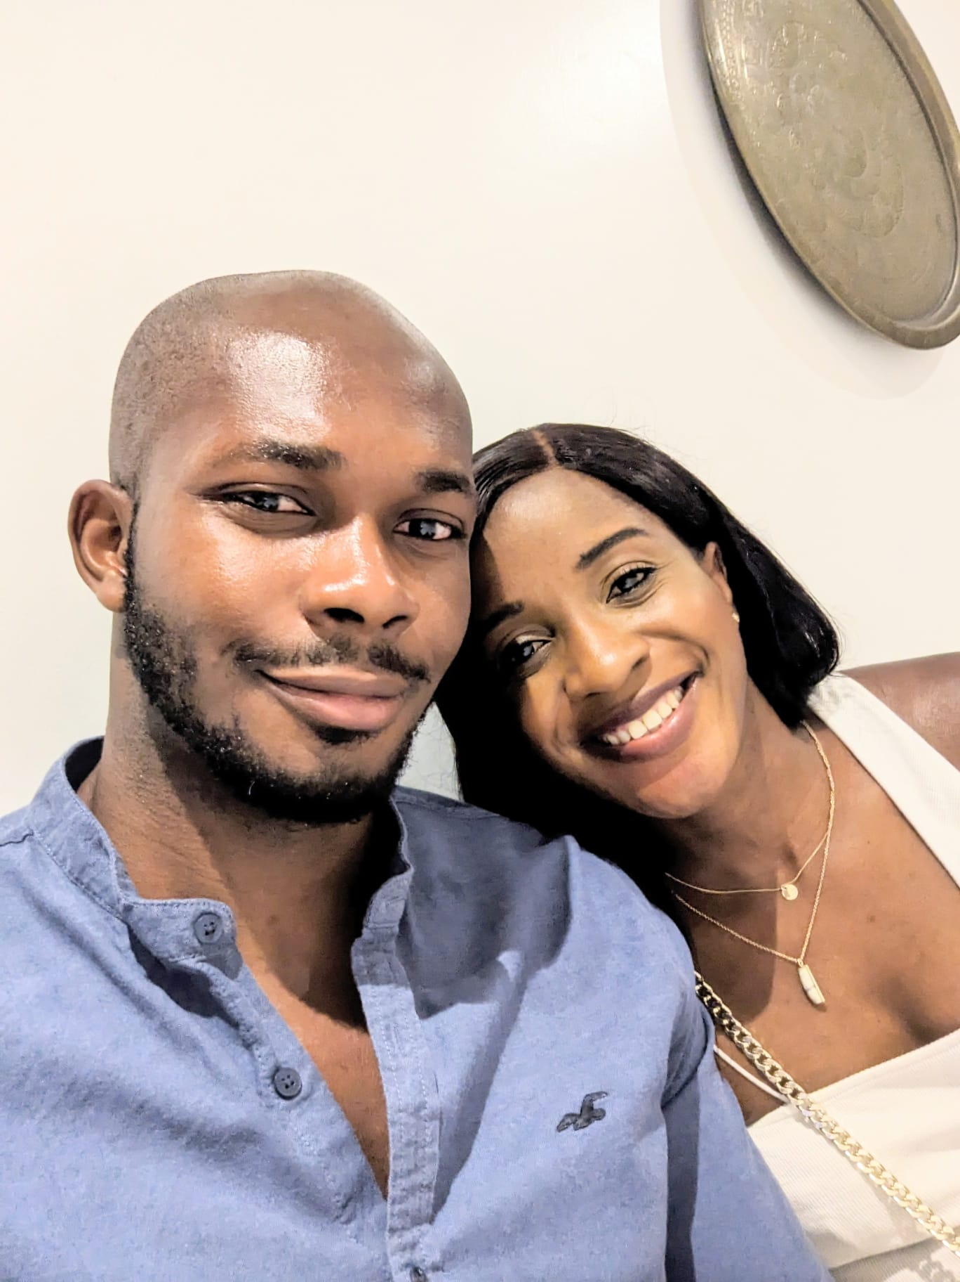

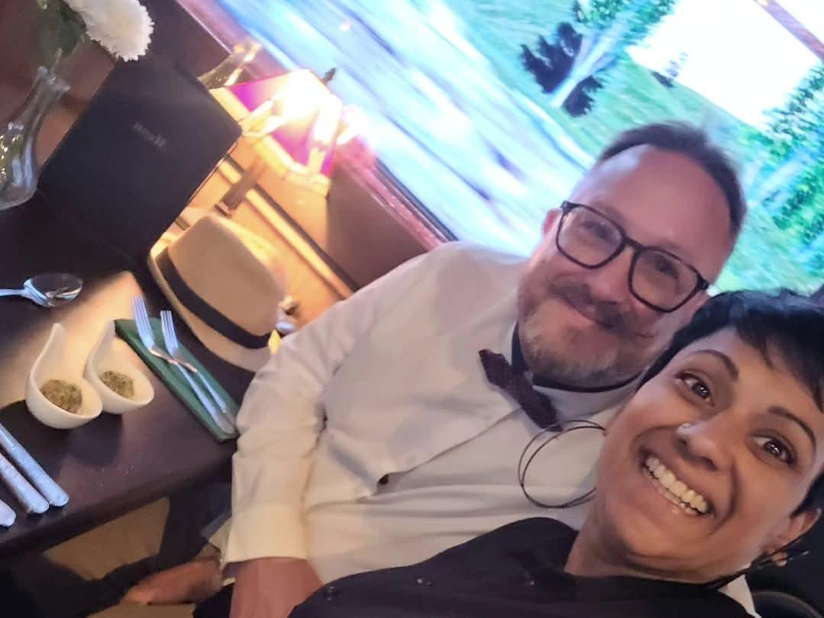
Group Leaders
Micheal and Mwamba
Wilfred and Parveen
Hannah

Slide 63
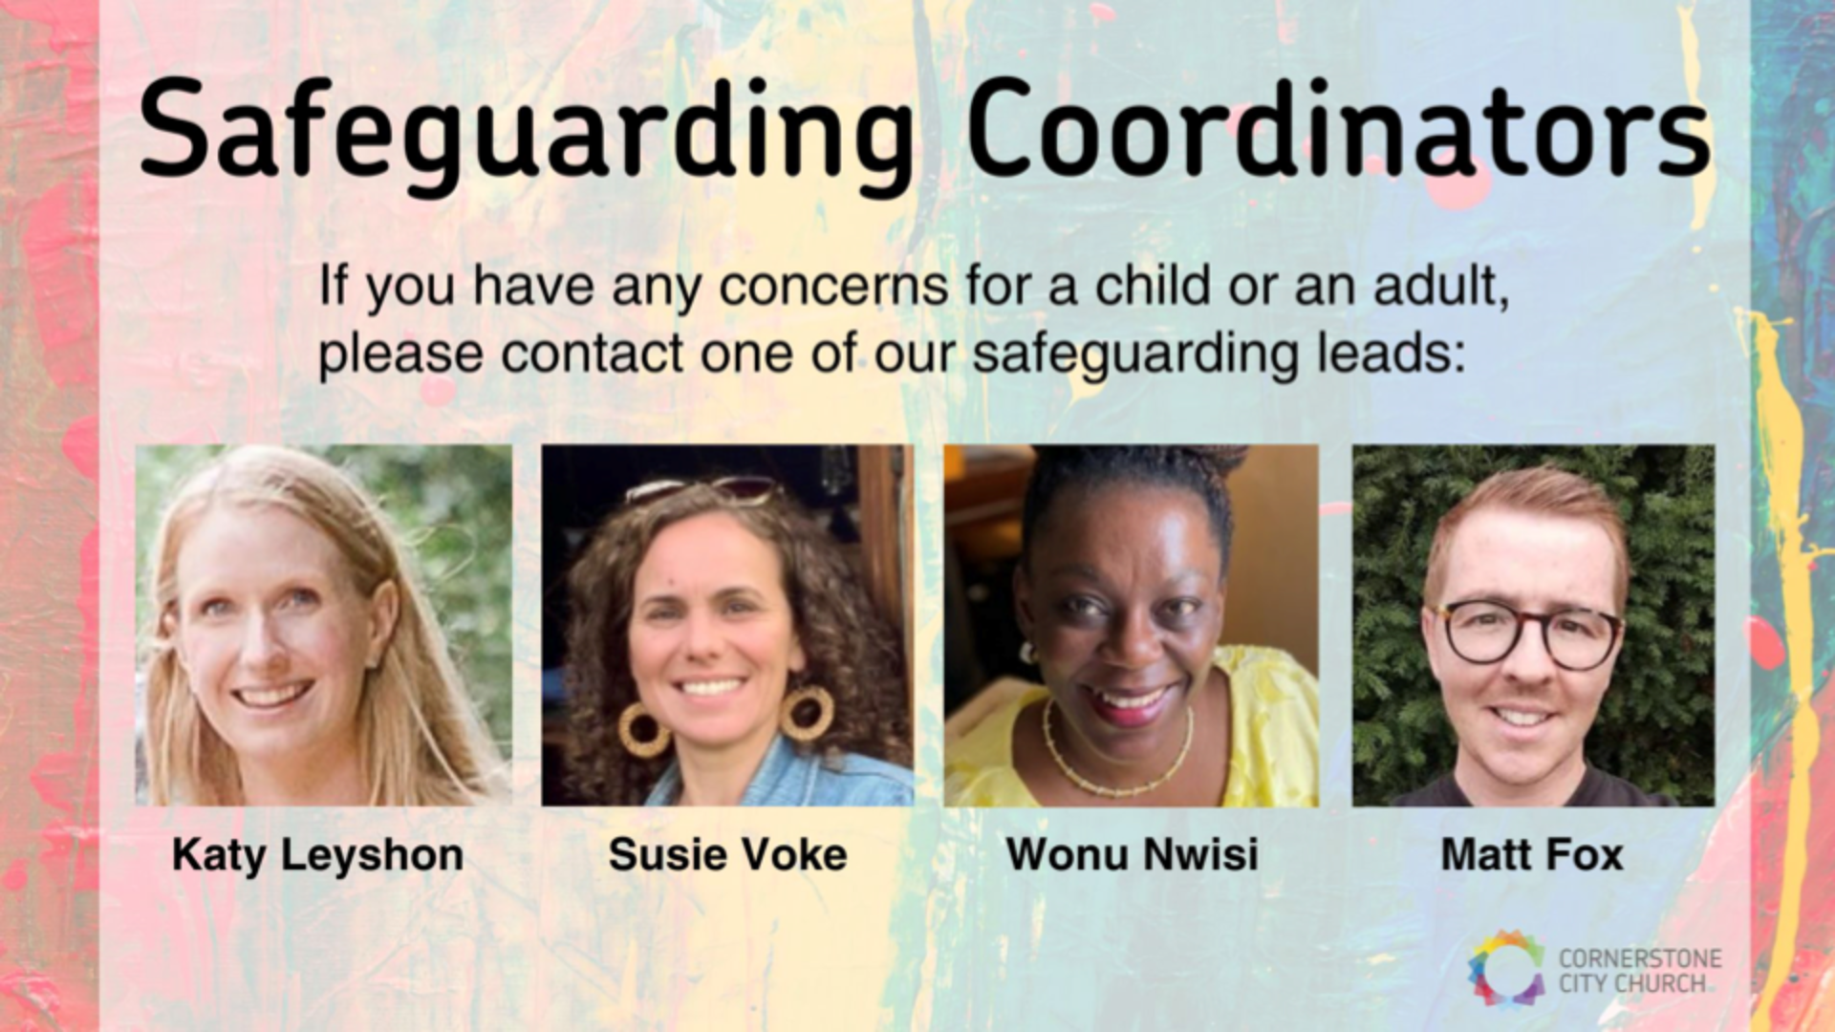

Slide 64


Slide 65




Slide 66
Thanks & Celebration
Father God,
According to your word, We give you thanks for every good gift that we have received in our lives. There are many.
On this day, I/we give you thanks for the gift of our child/children _________(say name/s). You are the creator and giver of life.
Knowing that you are with us by the Holy Spirit, we celebrate this day before you.
We do this along with our friends, family and church community for whom we also give you thanks.
In the name of Jesus we praise you.
Amen.

Slide 67
Dedicating
Father God,
I dedicate my child/children……….(say name/s) to your care and involvement. Trusting that you will work in their lives for salvation by your Holy Spirit. May they grow to know and serve you.
May they be a Christ-like blessing to their friends, family and to society as they grow older.
We dedicate ourselves to love our child/children, to provide and care for them.
We will teach them your ways through the wisdom of your word.
Amen

Slide 68
Asking
Father God,
You are the perfect Father and so we pray for your wisdom in our parenting.
We ask that your grace and strength would carry us through every season, both easy and hard. Help us through every challenge and pressure faced.
May we all grow together, stronger and deeper as a family as your Spirit works in us.
Help us to make right choices that will promote righteousness and truth in the lives of our child/children_________(say name/s).
We ask this in Jesus name
Amen

Slide 70


Slide 71


Slide 72
Mark 10 v 13-16 NIV
People were bringing little children to Jesus for him to place his hands on them, but the disciples rebuked them,
When Jesus saw this, he was indignant, he said to them “let the little children come to me, and do not hinder them, for the kingdom of God belongs to such as these”
“Truly I tell you, anyone who will not receive the kingdom of God like a little child will not enter it”
And he took the children in his arms, placed his hands on them and blessed them.

Slide 73
Key words
Rebuked - sharp disapproval or criticism of someone because of their behaviour or actions. (rebuked,warn,sternly,strictly warn)
Indignant - feeling or showing anger or annoyance at what is perceived as unfair treatment
Hinder - making it difficult for someone to do something, or something to happen. (stop,restrain,oppress,oppose)
Truly I tell you - solemn affirmation, emphasize the importance of a statement.

Slide 74
People were bringing little children to Jesus for him to place his hands on them, but the disciples rebuked them,
When Jesus saw this, he was indignant, he said to them “let the little children come to me, and do not hinder them, for the kingdom of God belongs to such as these”

Slide 75
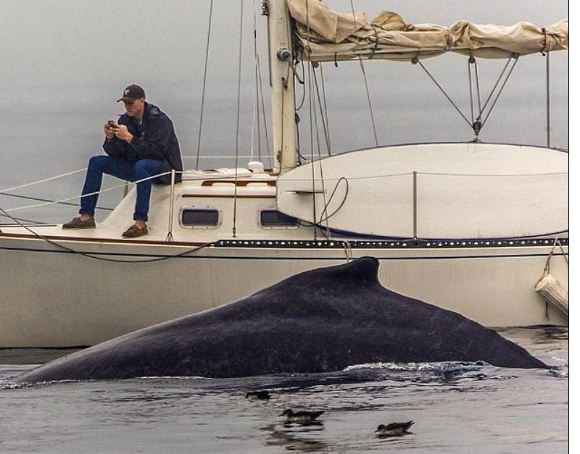
We need to stay vigilant, keep watch and be consistent
We need to stay vigilant, noticing and making conscious decisions, we won’t get them all right we are human, but if noticing and making a decision we are halfway there.
What would have happened if he hadn’t have stepped in, how might the mothers/children have felt?
We all have regular choices on what we let go and what we don’t, how we respond, particularly important here given the recent teaching he had to follow up and be consistent.

Slide 76
Jesus calls everyone and just asks us to come with dependence on him, we are all qualified don’t disqualify yourself or allow others to disqualify you.
We all have a role to play both within a church setting but also in other locations God has called us to be.
Matthew 25 v 14
Again it will be like a man going on a journey, who called his servants and entrusted his wealth to them. To one he gave five bags of gold, to another two bags, and to another one bag, each according to his ability, Then he went on his journey.

Slide 77
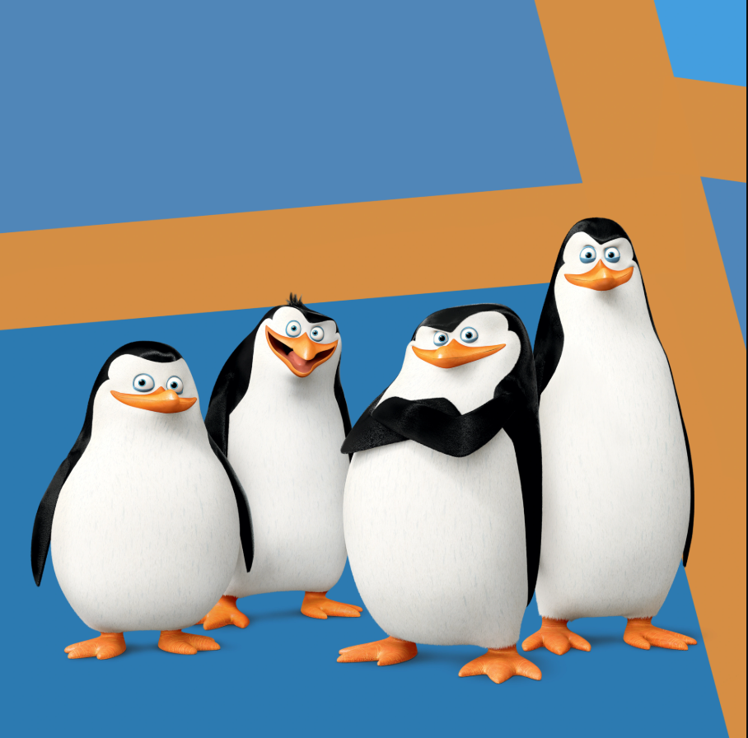
For God gave us a spirit not of fear but of power and love and self-control. (2 Tim 1-7) Don’t live by your own power or understanding. No, live by my Spirit within you (Zechariah 4:6; Proverbs 3:5).
The Spirit will guide you into all truth, help you to obey me, and empower you to do my work (John 16:7, 13; Acts 1:8; Galatians 5:16).

Slide 78
“Truly I tell you, anyone who will not receive the kingdom of God like a little child will not enter it”
And he took the children in his arms, placed his hands on them and blessed them.

Slide 79
Receive like a child, with childlike faith
The kingdom of God is an open invitation, must be received as a gift, can’t be achieved by human effort.
We enter by knowing we are helpless, without claim or merit, vulnerable and dependent.
Other childlike qualities
Trust, keep simple, not doubting, not worrying, dream big, get excited, not afraid to invite, give, dependent - they know what they have comes from their parents.

Slide 80
2 Corinthians 14 May the grace of the Lord Jesus Christ, and the love of God, and the fellowship of the Holy Spirit be with you all
Surely goodness and mercy shall follow me all the days of my life, and I shall dwell in the house of the Lord forever.

